Slide 1
Linux OS
Project 1
陳品豪 – 106522102
賴孟昇 – 106522066
陳韋佑 – 106522033

Slide 2
Linear Address
Linux x86_64 version:4.0.4

Slide 3
Linear Address
pgtable
Because of Canonical Form
0x000000000000000
0x00007fffffffffff
0xffff800000000000
0xffffc80000000000
0xffffe90000000000
User space 128 TB | Illegal Scope | Guard hole (for hypervisor) | Mapping of all phys. Memory (64 TB) |  | vmalloc
0x000080000000000
0xffff880000000000
0xffffc90000000000
0xffffe9ffffffffff
Physical Memory (Max. 64TB)
0x000000000000
0x‭3FFFFFFFFFFF‬
Linear Address
0xffffea0000000000
0xffffec0000000000
0xffffff0000000000
Virtual memory map |  | Kasan shadow memory |  | Stacks
Hole
1 TB
0xffffeb0000000000
16 TB
0xfffffc0000000000
0xffffff7fffffffff
Physical Address
0xffffff8000000000
0xffffffffa0000000
0xffffffffffe00000
 | Kernel text mapping | Module mapping space | vsyscalls
User Space (128 TB)
0xffffffff80000000
Default 512 MB
~1525 MB
0xffffffffff600000
0xffffffffffffffff
Kernel Space (128 TB)

Slide 4
User Space (128 TB)
Linear address range: 0x0000000000000000 – 0x00007fffffffffff
Each process has its own user space, so every process can arrange all 128TB.
User space uses 4-level page tables mapping physical memory above Linux 2.6.10. However, x86_64 is currently the only port that uses 4-level page tables.

Slide 5
User Space Linear Address Arrangement
0x00007FFFFFFFFFFF
Stack
Memory Mapping Segment
Heap
BSS Segment
Data Segment
Text Segment
Each process has its own user space!
File mapping (/lib/libc.so …), etc.
User Space
128 TB
Un-initialized global variables
Initialized global variables
Program
0x0000000000000000

Slide 6
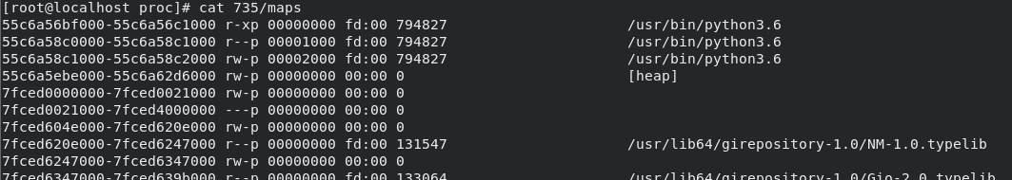
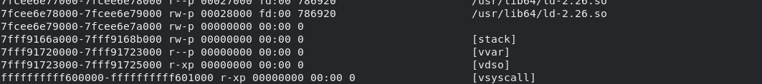
User Space
r = readable
w = writable
x = executable
p = private
Text Segment (r-x)
Data Segment (r--)
BSS Segment (rw-)
Try to “cat /proc/[pid]/maps”
Heap (rw-)
…
Memory Mapping Segment
Stack Segment (rw-)
System call (kernel space) (r-x)

Slide 7
Direct mapping of All Phys. Memory (64 TB)
Linear address range: 0xffff880000000000 – 0xffffc7ffffffffff
The direct mapping covers all memory in the system up to the highest memory address.
The maximum physical memory size of Linux x86_64 is 64 TB .

Slide 8
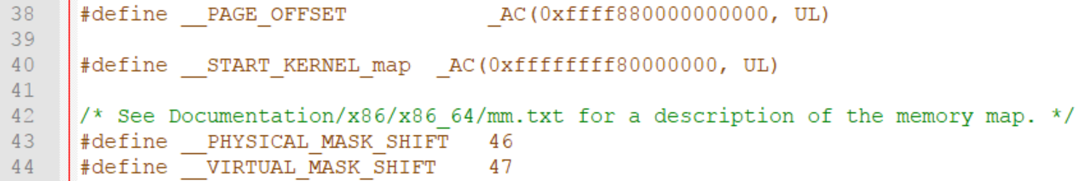
How Linux resolves the Physical and Virtual Address
File: arch\x86\include\asm\page_64_types.h
User Space Address length is 47 bits (128 TB), so the kernel uses mask to gain the specific range of user space.
According to the above, physical address length is 46 bits (64 TB), and it uses mask, too.

Slide 9
The Kernel Address Sanitizer (KASAN)
KernelAddressSANitizer (KASAN) is a dynamic memory error detector. It provides a fast and comprehensive solution for finding use-after-free and out-of-bounds bugs.
Currently KASAN is supported only for the x86_64 and arm64 architectures.
The state of each 8 aligned bytes of memory is encoded in one shadow byte.
AddressSanitizer dedicates 1/8 of kernel memory to its shadow memory (e.g. 16TB to cover 128TB on x86_64).

Slide 10
Kernel Text Mapping
File: arch\x86\include\asm\page_64_types.h
__START_KERNEL_map is the beginning address of kernel text mapping (0xffffffff80000000).
_AC(100, UL) is a macro which combines two parameters, for example, “100UL”.

Slide 11
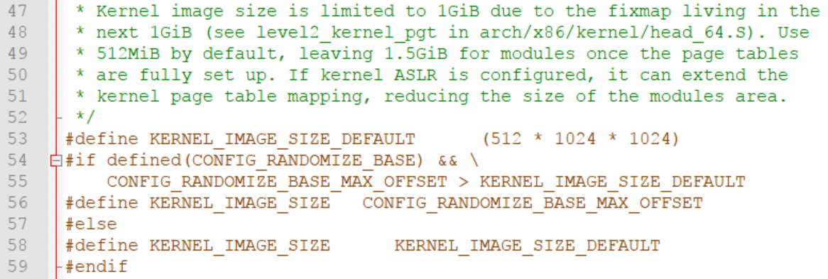
Kernel Text Mapping (2)
File: arch\x86\include\asm\page_64_types.h
The size of kernel text mapping range is 512 MB(default) to 1 GB.
The rest of 2GB is “Module mapping space” (1 GB ~ 1.5 GB).
P.S The size of kernel text mapping in latest version of Linux is either 512MB or 1GB

Slide 12
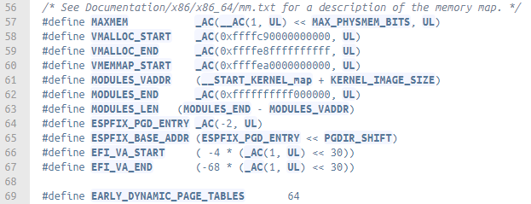
The Definition of Kernel Space Arrangement
File: arch\x86\include\asm\pgtable_64_types.h
The document defined MODULES_END is 0xffffffffff5fffff, but the code actually defined 0xffffffffff000000.

Slide 13
Segment
Linux x86_64 version:4.0.4

Slide 14
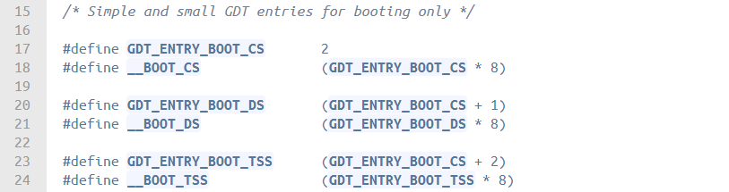
Linux GDT When Booting
When Linux is booting, there are only few entries in GDT.
File: arch\x86\include\asm\segment.h
Linux’s GDT when booting
Segment Selectors
null
reserved
GDT_ENTRY_BOOT_CS
GDT_ENTRY_BOOT_DS
GDT_ENTRY_BOOT_TSS
0x0
0x1
0x2
0x3
0x4

Slide 15
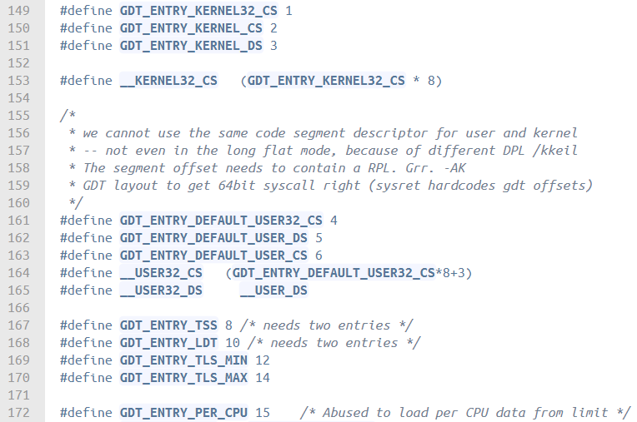
GDT in Linux x86_64
After booting, it expends to 16 entries.
File: arch\x86\include\asm\segment.h
The layout of the per-CPU GDT under Linux x86_64
Null [0]
KERNEL32_CS [1]
KERNEL_CS [2]
KERNEL_DS [3]
USER32_CS [4]
USER_DS [5]
USER_CS [6]
reserved
TSS#1 [8]
TSS#2 [9]
LDT#1 [10]
LDT#2 [11]
TLS#1 [12]
TLS#2 [13]
TLS#3 [14]
PER CPU [15]
…
There are only 16 entries in x86_64

Slide 16
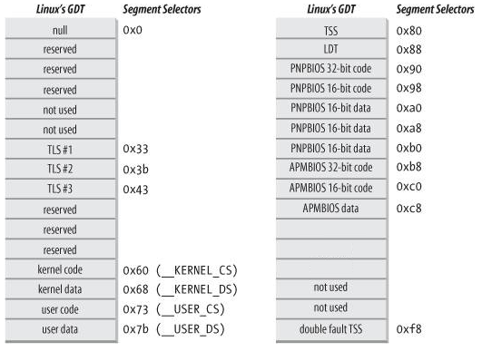
Differences between x86_64 and x86
The layout of the per-CPU GDT under Linux x86
The layout of the per-CPU GDT under Linux x86_64
Null [0]
KERNEL32_CS [1]
KERNEL_CS [2]
KERNEL_DS [3]
USER32_CS [4]
USER_DS [5]
USER_CS [6]
reserved
TSS#1 [8]
TSS#2 [9]
LDT#1 [10]
LDT#2 [11]
TLS#1 [12]
TLS#2 [13]
TLS#3 [14]
PER CPU [15]

Slide 17
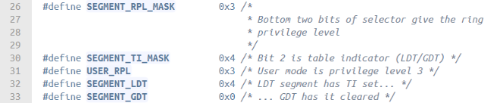
Segment Selector
Segment selector are made by 16 bits in Linux x86_64 (same as 32bit).
13-bit index
1-bit TI (Table Indicator) flag.
2-bit RPL (Requestor Privilege Level)
15
3
2
0
index
TI
RPL
Segment Selector
File: arch\x86\include\asm\segment.h

Slide 18
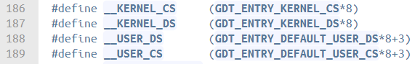
Segment Selector (2)
File: arch\x86\include\asm\segment.h
Segment Selector Content
* 8 (bit shift, equal to “<< 3”)
0000000000100
15
3
2
0
index
TI
RPL
Segment Selector
11
+3 (User Mode Privilege)

Slide 19
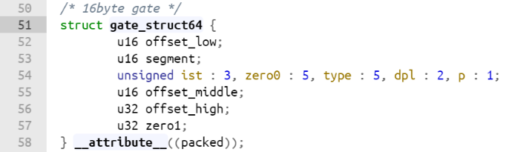
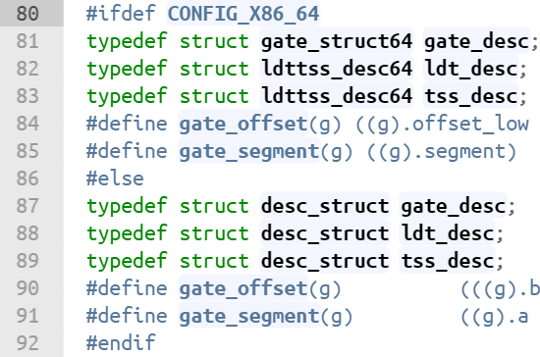
Data Structure of GDT Entry (16 bytes)
File: arch\x86\include\asm\desc_defs.h
File: arch\x86\include\asm\desc_defs.h
Re-define to gate_desc, no matter x86 or x86_64.
31
0
31
0
zero1
offset (high)
127
64
16
15
13
8
3
31
16
15
31
0
0
offset (middle)
p
dpl
type
zero0
ist
segment
offset (low)
63
0

Slide 20
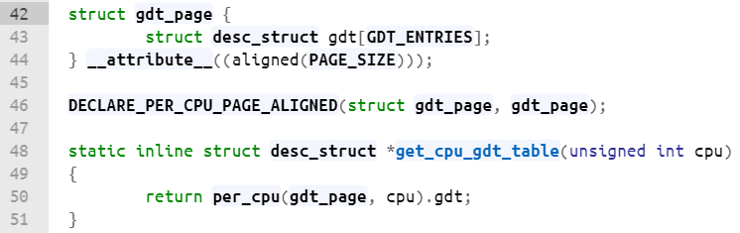
GDT Page
File: arch\x86\include\asm\desc.h
Define a array that contains all 16 entries.
Each CPU has its GDT.
Get a GDT from CPU id.

Slide 21
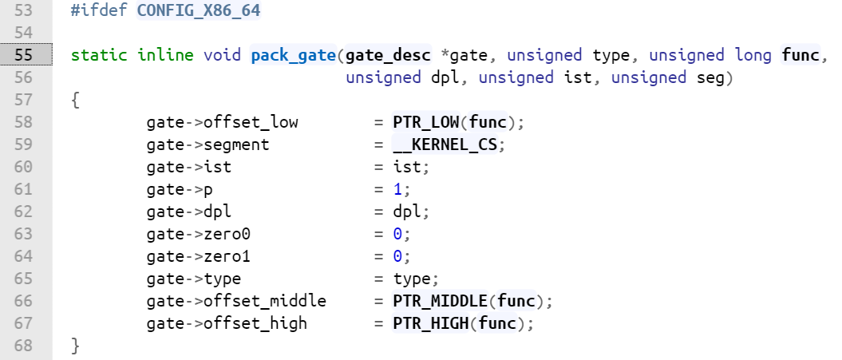
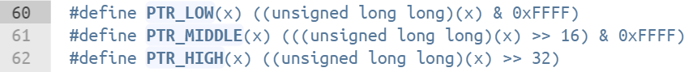
Create GDT Entry
File: arch\x86\include\asm\desc.h
File: arch\x86\include\asm\desc_defs.h
Split base address to three parts.

Slide 22
Translation of a Logical Address in x86_64
(64 bits)

Slide 23
Page
Linux x86_64 version:4.0.4

Slide 24
4-Level Page Tables
Linear Address has 48 bits, so the total accessible memory is 256 TB which is divided into 128 TB for User Space and 128 TB for Kernel Space.
The Linear Address is splitted into 4 tables and 4K index.
For example: 0000000000000000000101010101101010101101010101010101101010101011
Because of Canonical Form and only 48 bits are used, bit 49 – bit 64 (Preserved) need to be the same as bit 48.
(Preserved) 63 – 48 | PGD 47 - 39 | PUD 38 - 30 | PMD 29 - 21 | PTE 20 - 12 | Index 11 - 0

Slide 25
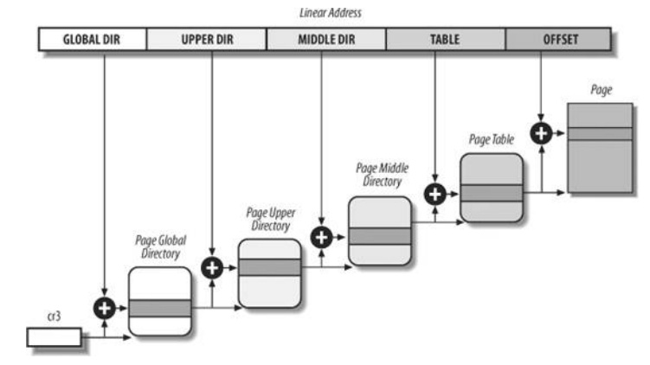
4-Level Page Tables (2)

Slide 26
pagemap
pagemap maps whole User Space.
Each pagemap entry is 8 bytes.
Each process has its own pagemap.
E.g. /proc/[PID]/pagemap
/proc/kpagecount. This file contains a 64-bit count of the number of times each page is mapped, indexed by PFN.
/proc/kpageflags. This file contains a 64-bit set of flags for each page, indexed by PFN.

Slide 27
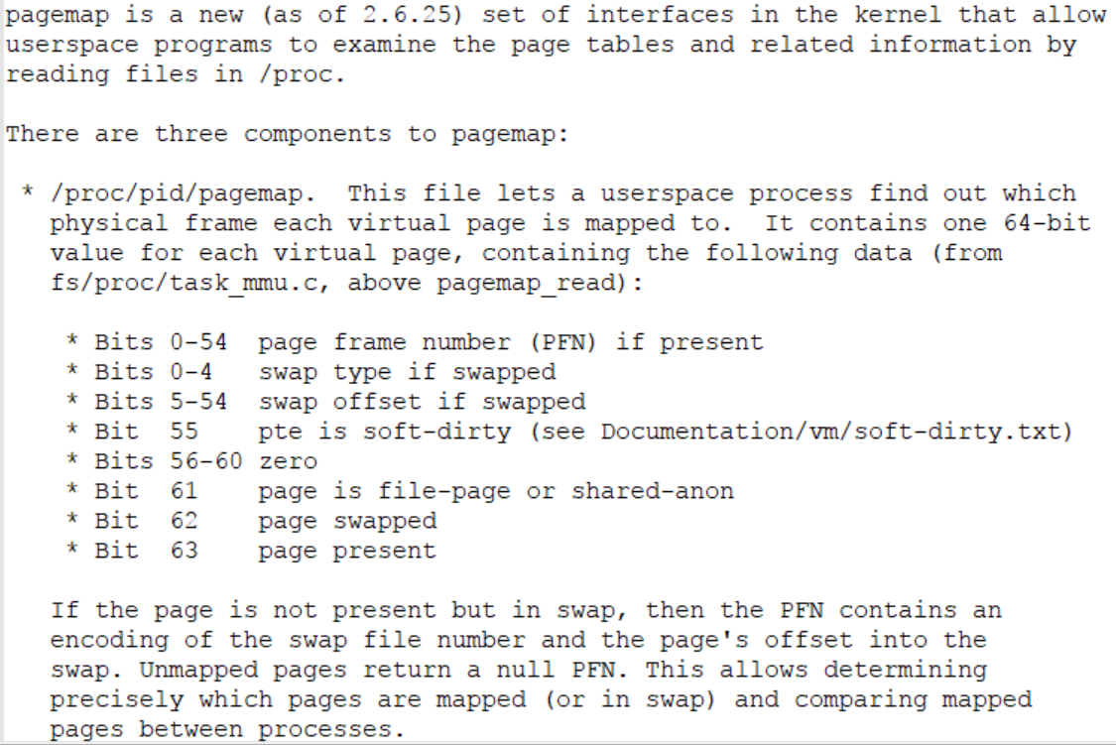
pagemap (2)
PFN = Page Frame Number.
Each pagemap entry is 8 bytes
Page is in RAM or swap file.
Page is present or not.
More detail of pagemap entry, please refer to linux-kernel\Documentation\vm\pagemap.txt

Slide 28
Get PFN From “pagemap” Using Program
Page Size = 4096 (4096 bytes per page)
pagemap entry size = 8 (8 bytes per entry)
file_offset = [Linear address] / 4096 * 8
Read the pagemap file of a process (“/usr/[pid]/pagemap”). (You cannot just ‘cat’ the pagemap, because it is bytes serial)
Index to file_offset and read the following 8 bytes (Read a whole entry).
Resolve PFN or swap offset.

Slide 29
How Linux Access Page Table - pgtable
Get a next level table page from upper page table with a entry offset address
static inline pte_t *pte_offset_kernel(pmd_t *pmd, unsigned long address) {…}
/* Find an entry in the second-level page table.. */
static inline pmd_t *pmd_offset(pud_t *pud, unsigned long address) {…}
/* to find an entry in a page-table-directory. */
static inline pud_t *pud_offset(pgd_t *pgd, unsigned long address) {…}
/* pgd_index() is used get the offset into the pgd page's array of pgd_t's */
#define pgd_offset(mm, address) ((mm)->pgd + pgd_index((address))) // pgd_offset() returns a (pgd_t *)
Check the directory/table is present or not
static inline int pgd_present(pgd_t pgd) {…}
static inline int pud_present(pud_t pud) {…}
static inline int pmd_present(pmd_t pmd) {…}
static inline int pte_present(pte_t a) {…}

Slide 30
Pgtable (2)
And then…You need to index a entry in a directory
#define pgd_index(address) (((address) >> PGDIR_SHIFT) & (PTRS_PER_PGD - 1))
static inline unsigned long pud_index(unsigned long address) {…}
static inline unsigned long pmd_index(unsigned long address) {…}
static inline unsigned long pte_index(unsigned long address)
pgd_t/pud_t/pmd_t/pte_t is the array like: pgd_t[PTRS_PER_PGD], the return value(unsigned long) is a index of array.
NOW, you get a entry! Next step is to obtain a PFN of next level directory/table from a entry.

Slide 31
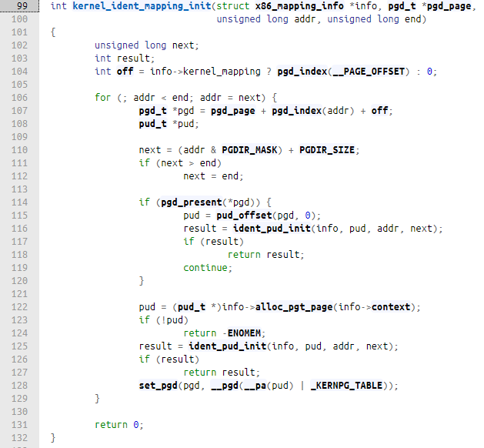
From Entry Index to Next Level Table Entry
It just a demo how to translate ->
File: arch\x86\mm\init_64.c
The off is a kernel mapping offset
Get a entry index in pgd
Get a PGD entry
PGD base address
Check the entry is present or not
Get the PUD base address in the entry
If the index of the table array is a entry (present), you get a entry. You may resolve the PFN from the entry.
PFN : Page Frame Number, represent the physical address of page directory/table or a page.

Slide 32
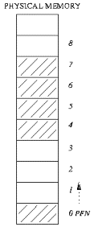
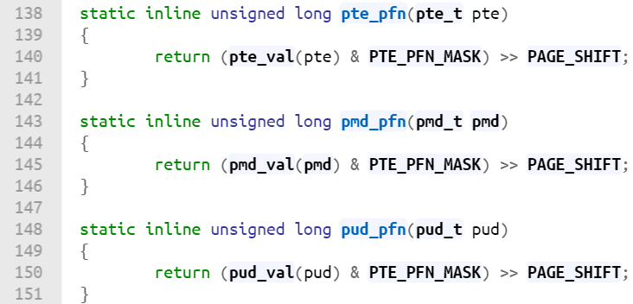
How Linux Obtains PFN From Page Table Entry
When Linux obtains a PUD/PMD/PTE 64 bits page table entry, then it will convert the entry to PFN.
File: arch\x86\include\asm\pgtable.h
00..0011..1100..00
└ 18 ┘└ 34 ┘└ 12 ┘
PFN 4K
00..0000..0011..11
└ 12 ┘
4K
Result: 34 bits PFN
PFN is a serial number every 4K block.
E.g. PFN=0 -> 0K
PFN=1 -> 4K
PFN=2 -> 8K
PTE_PFN_MASK extracts the PFN from a (pte|pmd|pud|pgd)val_t

Slide 33
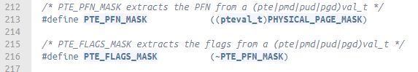
Page Table Entry Structure
pgd_t.pgd, pud_t.pud, pmd_t.pmd, pte_t.pte (Linux wraps a layer).
unsigned long (64 bits)
47
13
0
Flag (18 bits) | PFN (34 bits) | Flag (12bits)
File: arch\x86\include\asm\pgtable_types.h
The remaining bits of PFN is the flags of the page table or a page.

Slide 34
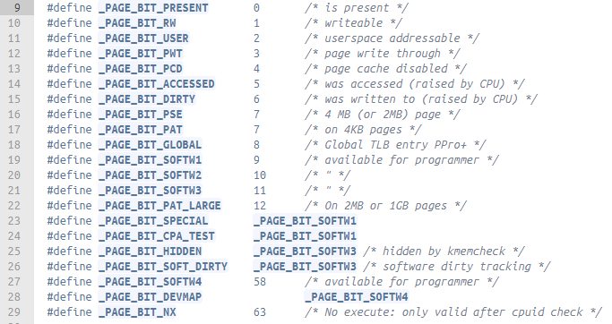
Page Table Entry Flag
File: arch\x86\include\asm\pgtable_types.h

Slide 35
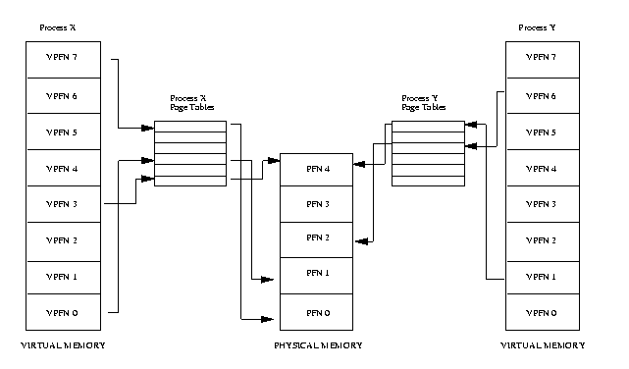
PFN Represents a Physical Address

Slide 36
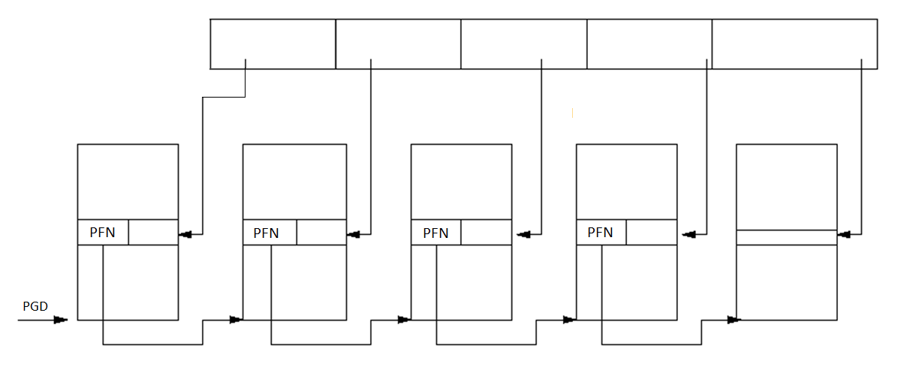
Page Table Entry and PFN
VIRTUAL ADDRESS
PGD(9)
PUD(9)
PMD(9)
PTE(9)
Offset(12)
PGD
TABLE
PUD
TABLE
PMD
TABLE
Page
Table
Physical
Page

Slide 37
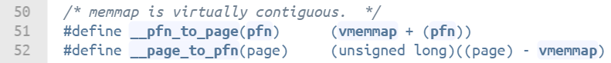
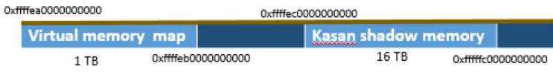
PFN to Page Struct
Do the same thing
File: arch\x86\include\asm\pgtable.h
File: include\asm-generic\memory_model.h
Get a “page struct” from virtual memory map.

Slide 38
So we can do this for getting a “struct page” from linear address
pgd_t * pgd;
pud_t * pud;
pmd_t * pmd;
pte_t * pte;
struct page *page = NULL;
pgd = pgd_offset(mm, address);
pud = pud_offset(pgd, address);
pmd = pmd_offset(pud, address);
pte = pte_offset_map(pmd, address);
page = pte_page(*pte);

Slide 39
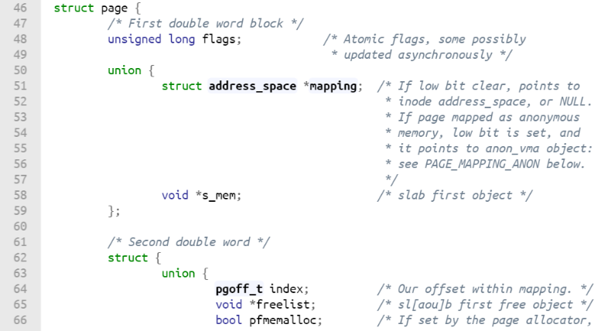
struct page
File: include\linux\mm_types.h
Page structure describes a page and uses lots of union in order to reduce size of each page frame.
Describe the status of the page
mapping = 0 : swap cache
mapping->bit[0] = 0: file mapping
mapping->bit[0] != 0 : anonymous mapping
The offset of mapping virtual memory address area.
(if you are mapping a file, you do not need to mapping all the file)

Slide 40
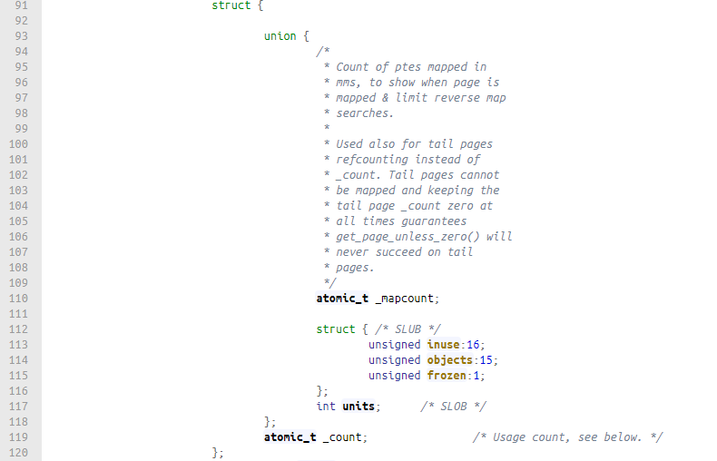
struct page (2)
File: include\linux\mm_types.h
Counter of mapping times, in other words, how many process mapping this page.
When the kernel is accessing this page, the _count will +1, after accessing will -1

Slide 41
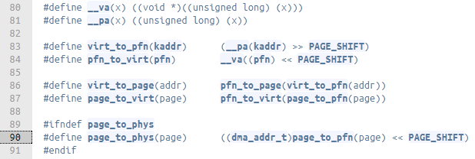
struct page (3)
When you get the PFN, you also get the physical address.
The “struct page” is like page descriptor stored in “virtual memory map” area.
Of course, you can get a physical address from “struct page”, but…
File: include\asm-generic\page.h
Still convert back to PFN

Slide 42
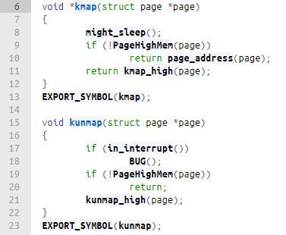
Page Mapping in Kernel
File: arch\x86\mm\highmem_32.c
Mapping in kernel memory
Un-mapping in kernel memory

Slide 43
Kernel
Linux x86_64 version:4.0.4

Slide 44
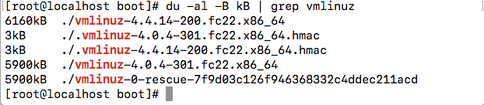
Linux 4.0 Kernel Size
The size of Linux kernel 4.0.4 is 5900 kB. (1 k = 1000)

Slide 45
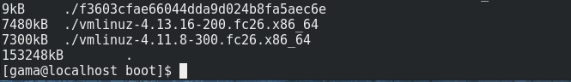
Linux 4.0 Kernel Size
But we found that there are differences between different versions.
Vmlinuz-4.0.4-301 -> 5900 kB
Vmlinuz-4.4.14-200 -> 6160 kB
Vmlinuz-4.11.8-300 -> 7300 kB
Vmlinuz-4.13.8-300 -> 7400 kB

